Slide 1
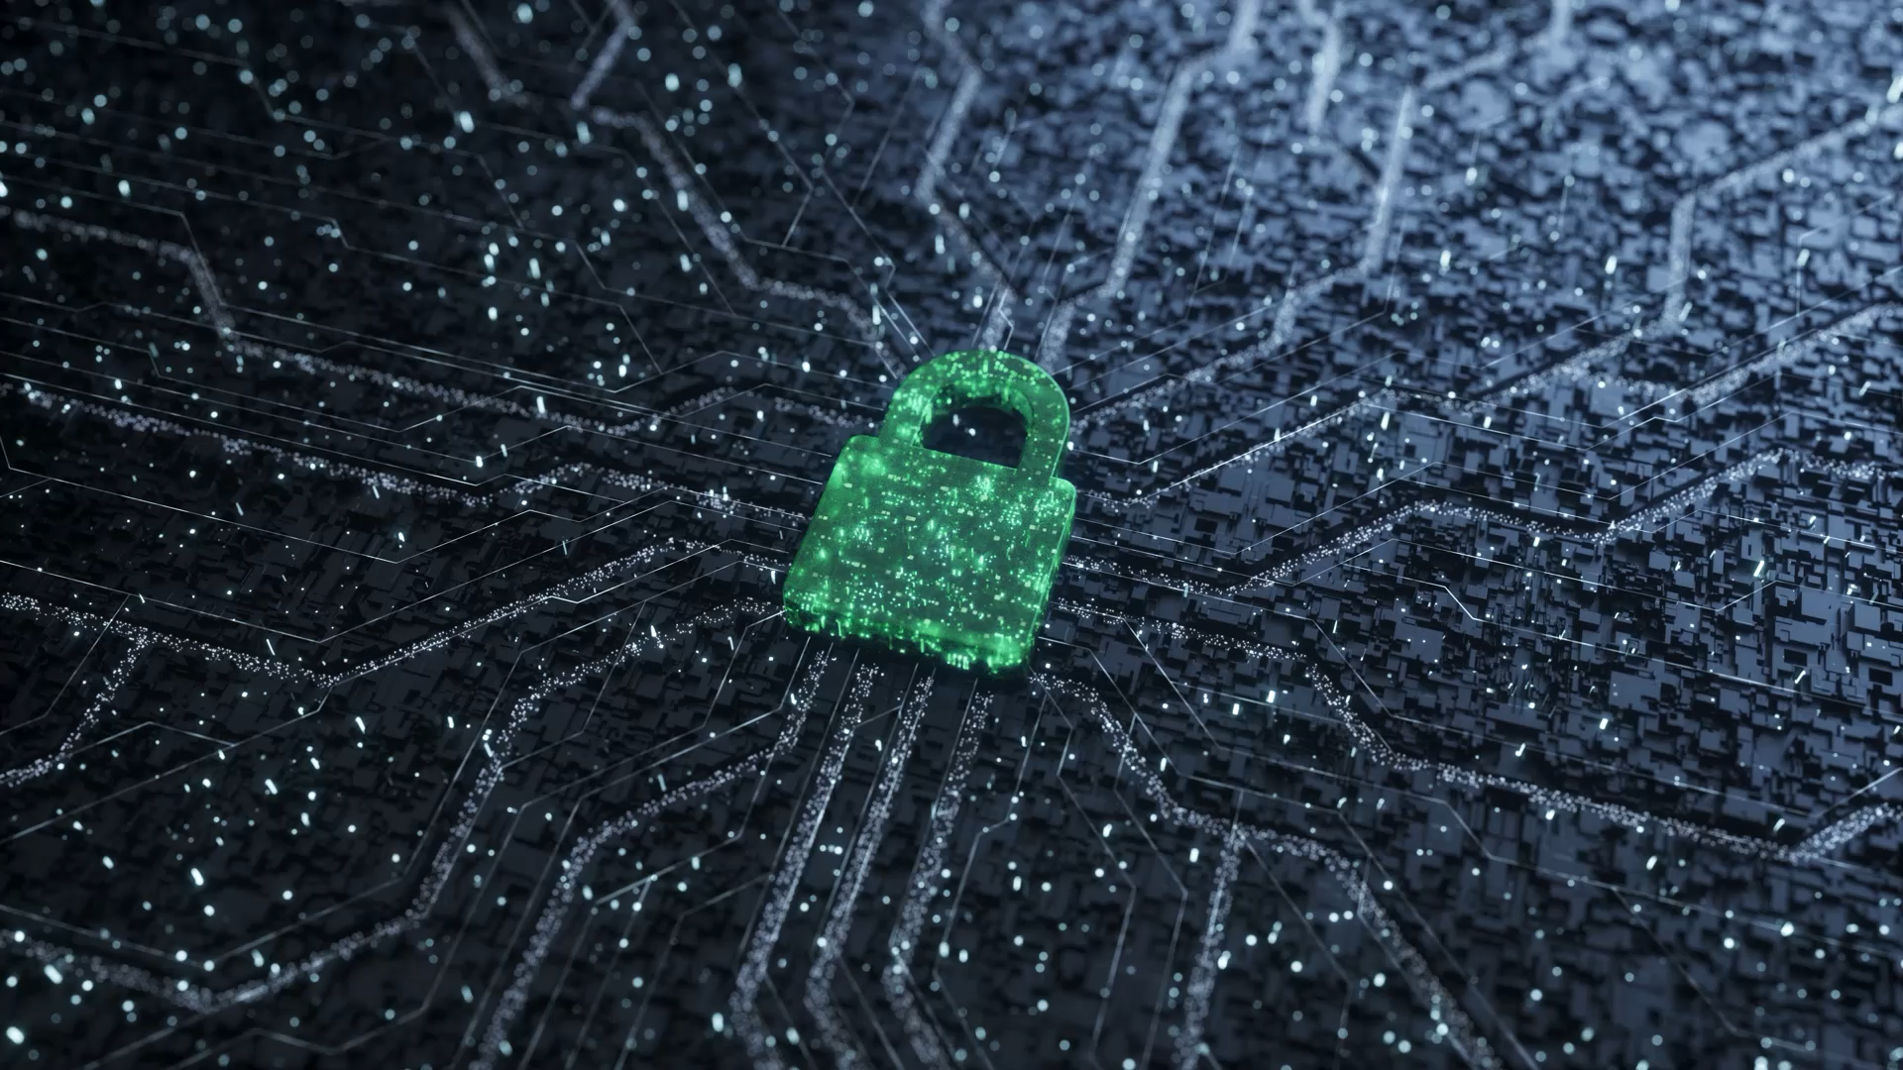
Cybersecurity 2025
part of Fabrizio d’Amore
6 of 9 ECTS

Slide 2
contents
Cybersecurity, CNS and Web security and privacy (long and partially sad story)
Part of d’Amore (6 ECTS) and part of Querzoni (3 ECTS)
Google classroom: baomarw4
slides (both in advance - tentatively - and in retrospect; they may slightly differ)
Website: https://sites.google.com/diag.uniroma1.it/cybersecurity/
Calendar
Textbook
Log
Classroom

Slide 3
contents (continued)
Homeworks
Exam
Mandatory written test
Oral exam optional (grade positive or negative)
Partial grade handling (Including people who for any reason have not been able to formalize official enrolment in the master's degree)
Reset: after September call
Final grade is (2/3)(d’Amore)+(1/3)(Querzoni)
Organization of the lectures
Only in presence
Proposal: 67.5min + 30min break + 67.5min (Thursday break might be shorter)
Master theses
Many and demanding

Slide 4
Syllabus 2024
Information security
Symmetric encryption
Data integrity
Public key encryption
Digital signatures and PKI
CSPRNG (Cryptographically Secure Pseudo-Random Number Generators)
Authentication
Secret sharing
Access control
Secure protocols (tls, ipsec, ssh)
Firewalls
only d’Amore
Tentatively 2025 like 2024
But Log 2025 is the official reference

Slide 5
information security
everything starts here
CIA requirements
other (non-secondary) requirements
what is a requirement?
safety vs. security

